Slide 1
President Donald J. Trump Unveils National AI Legislative Framework
Week of March 30th
Elias Hord

Slide 2
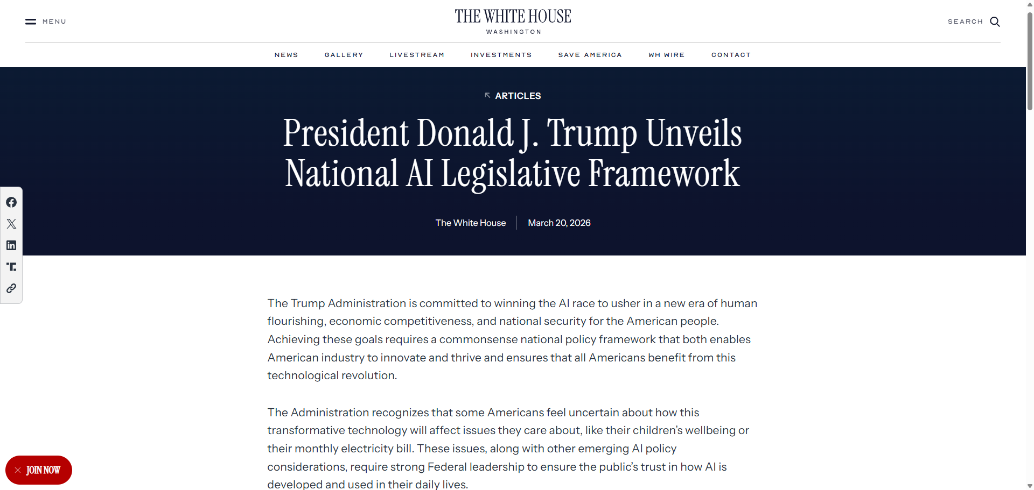
General Information
Article Publication: March 20, 2026
https://www.whitehouse.gov/articles/2026/03/president-donald-j-trump-unveils-national-ai-legislative-framework/

Slide 3
Main Findings and Arguments
Federal control over AI regulation: The framework strongly emphasizes creating a single national standard for AI, aiming to override or limit a patchwork of state-level laws. The administration argues that inconsistent state regulations slow innovation and create compliance challenges.
“Light-touch” regulatory approach: The proposal promotes minimal government interference to accelerate AI development and maintain U.S. global leadership. Instead of strict regulation, it favors flexible oversight through existing agencies rather than creating a new AI regulator.
Key priority areas:
Child safety protections (age controls, limits on harmful content)
Free speech protections (preventing AI-driven censorship)
Intellectual property handled by courts rather than new laws
Consumer protections against scams and misuse of AI
Energy and infrastructure support for AI data centers
Economic and global competition focus: The framework is designed to ensure the U.S. remains competitive with countries like China by encouraging rapid AI innovation and deployment.

Slide 4
Broader Implications for Society
Centralization vs. states’ rights: A major implication is the shift of regulatory power from states to the federal government, which could standardize AI rules but also spark political and legal conflict.
Faster AI adoption: A lighter regulatory approach may accelerate AI integration across industries, potentially boosting economic growth—but also increasing risks if safeguards are insufficient.
Public safety and ethical concerns: While the framework addresses issues like child protection and scams, critics note it lacks detailed provisions on national security and long-term AI risks, leaving gaps in oversight.
Energy and infrastructure impact: Expanding AI infrastructure (like data centers) could significantly increase energy demand, influencing environmental policy and electricity costs.
Free speech and digital rights: Strong emphasis on preventing AI censorship may shape how platforms moderate content, potentially affecting misinformation and political discourse.

Slide 5
Relevance or Potential Influence on the Construction Industry
Growth in AI-related infrastructure projects: The push for expanded data centers and energy facilities will likely increase demand for:
Large-scale construction projects
Electrical infrastructure upgrades
Renewable and on-site energy systems
Streamlined permitting and development: Policies supporting AI infrastructure could lead to faster approvals and reduced regulatory barriers, benefiting construction firms involved in tech and energy builds.
Adoption of AI in construction workflows: A pro-innovation environment may accelerate:
AI-driven project management
Automation in scheduling and safety monitoring
Predictive analytics for cost and risk
Labor and workforce shifts: Increased AI adoption could:
Improve productivity on job sites
Reduce demand for some manual roles
Increase demand for tech-skilled construction workers
Regulatory clarity for AI tools: A unified federal framework may make it easier for construction companies to deploy AI technologies across multiple states without navigating inconsistent laws.

